Slide 1


Final Project
Author:Kamza Dias
Group:SE-2001

Slide 2

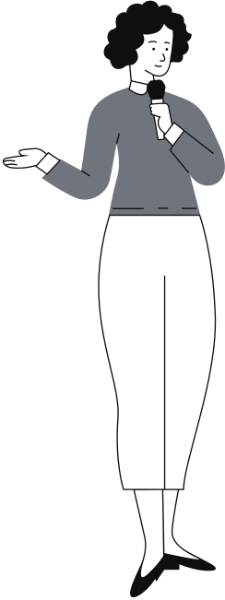
Plan of presentation
1
Topic
2
Methodology
3
Results​
5
4
Conclusion and reference

Slide 3


Topic
Telegram bot to receive information about stomatology in Kazakhstan
Purpose
The main goal of the project is to facilitate the search for dental clinics by providing all the necessary information, such as addresses, contact numbers, reviews, prices, and services, as well as ratings. This will allow people to choose the closest, inexpensive, and comfortable dentistry.

Slide 4

Resources
YouTube channels
Websites: habr,gitbook
Stackoverflow
Telebot Documentation
Data collection
https://www.dent-lux.kz/
https://labsmile.me/SITE
https://doctor-dent.kz/
https://impladent.kz/
Programs
•PyCharm 2020.2.3 (JetBrains).
•Python 3.8 (Microsoft Store)
•Telegram messenger

Slide 5


Results

Slide 6
TASK
9.11.20
10.11.20
11.11.20
12.11.20
13.11.20
14.11.20
15.11.20
16.11.20
17.11.20
18.11.20
19.11.20
20.11.20
Obtaining basic information about the project
Choose a theme for the project
Self-study on creating the project.
Writing Python code.
Working on the design.
Writing reports

Slide 7
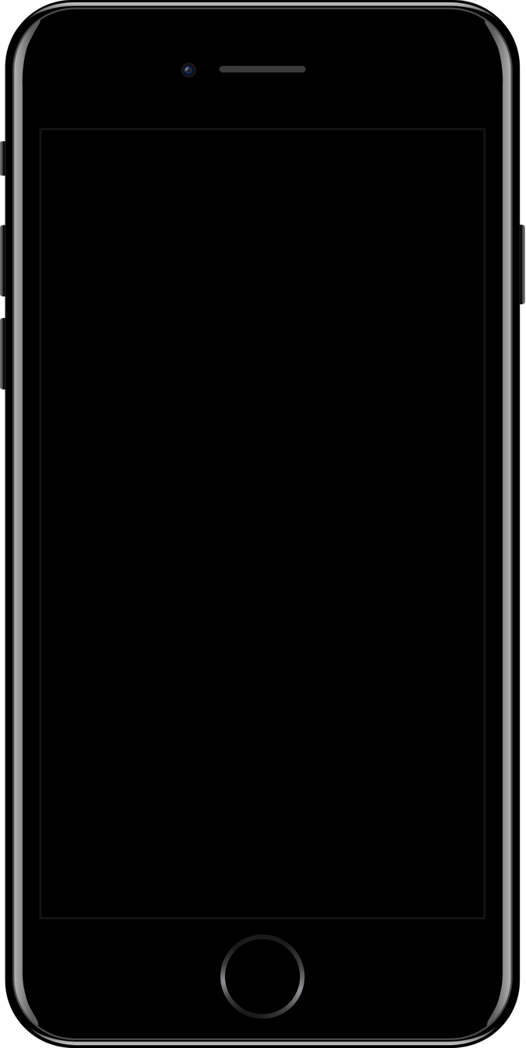
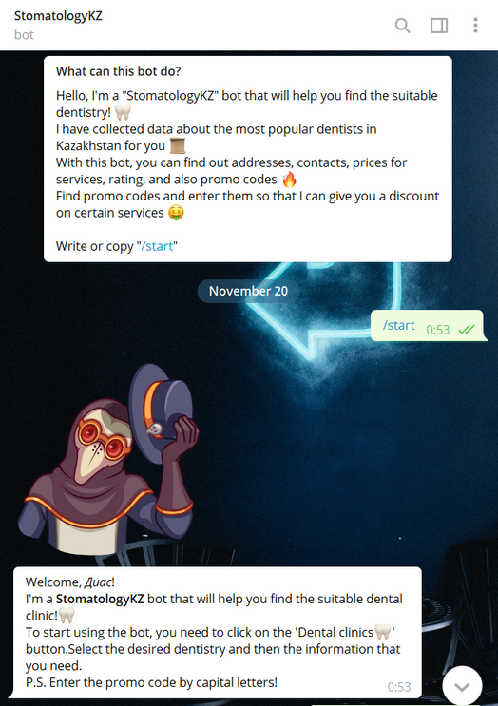
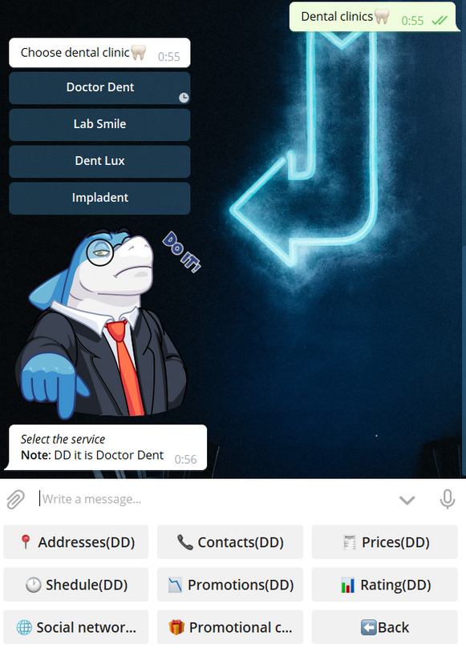
Bot features
During the two weeks, I created a bot called StomatologyKZ.
Picture 1
The bot greets the person with a sticker and shows its capabilities at the beginning.
Picture 2
The bot allows you to choose a dental clinic and then services.

Slide 8
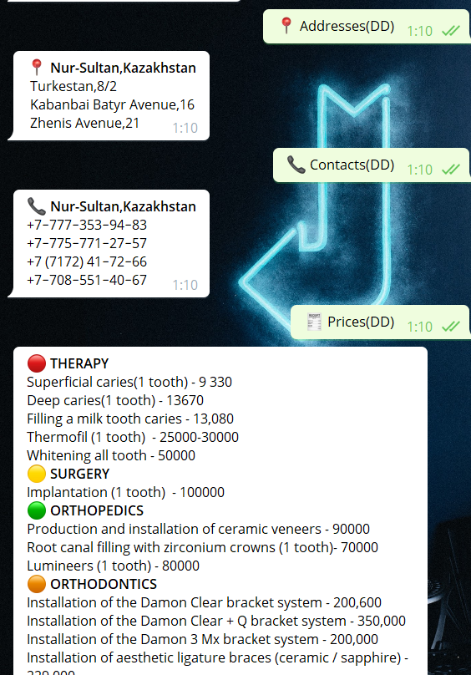
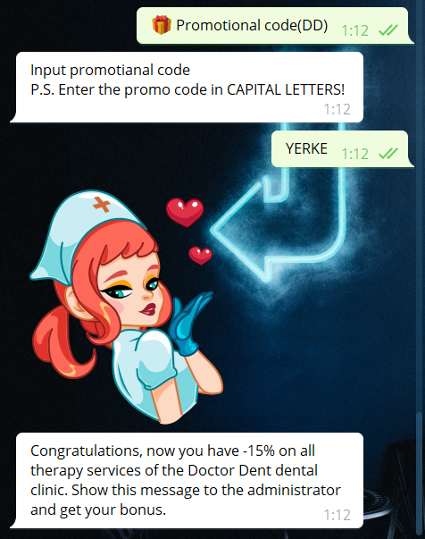
Picture 1
A person learns only what he wants. All information is official.
Picture 2
One of the cool features in the bot is promo codes

Slide 9


+ and -
Advantages
Conveniently.
Quickly.
Reliable information.
Cross-platform.
Disadvantages
Data refresh

Slide 10



Conclusion
Many people do not visit a dental clinic every day because of the high cost of services, remoteness, lack of trust, or simply laziness to search for information about dental clinics. Taking these factors into account, I created a Telegram bot during a 2-week training practice that will combine all the necessary information, such as addresses, contacts, prices, social network services, etc.,

Slide 11

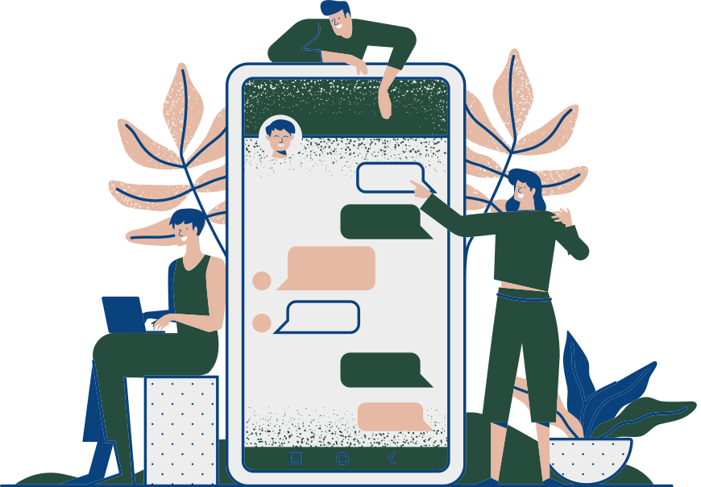
Links(GitHub)
https://github.com/kamzadias/StomatologyKZ.git

Slide 12
Reference List
Abdel Aal, A. (2020). How to Create a Telegram Bot. Retrieved 18 November 2020, from
https://www.toptal.com/python/telegram-bot-tutorial-python
Cosmodent (n.d). Tips for Choosing the Best Dental Clinic. Retrieved 14 November 2020, from
https://www.cosmodentindia.com/blog/dental-clinic/tips-for-choosing-the-best-dental-clinic
Indian Claims. (2019, August 8). Best Tips on Choosing The Right Dentist and Dental Clinic – Indian Claims Retrieved 14 November 2020, from
http://indianclaims.ca/best-tips-on-choosing-the-right-dentist-and-dental-clinic/
Telegram. (2020). Bots: An introduction for developers. Retrieved 18 November 2020, from https://core.telegram.org/bots
Telegram (n.d). Telegram Bot API. Retrieved November 12, 2020 ,from https://core.telegram.org/bots/api
WeCure (n.d). 5 Factors to Consider when Choosing the Right Dental Clinic. Retrieved 14 November 2020, from
https://wecure.co.uk/5-factors-to-consider-when-choosing-a-dental-clinic/

